Slide 1



GROUP 13
Recruitment
Nicole Ou, Rachel Wang, Ryosuke Oguchi

Slide 2
01
Business Problem
02
Human In The Loop
TABLE OF
03
Live Demo
Contents
Business Impact
04
05
Lessons Learned
06
Challenges
Future Development
07

Slide 3
BUSINESS PROBLEM
Poorly defined job descriptions
Auto-generate targeted job descriptions
ATS parsing errors + Inconsistencies
Standardize resume data with smart parsing
Resume screening
Instantly rank top candidates
Manually review candidate profiles
Summarize candidate profiles
Interview coordination
Self-service scheduling via Calendly links
Offer letter drafting
Auto-fill offer letters and contracts

Slide 4
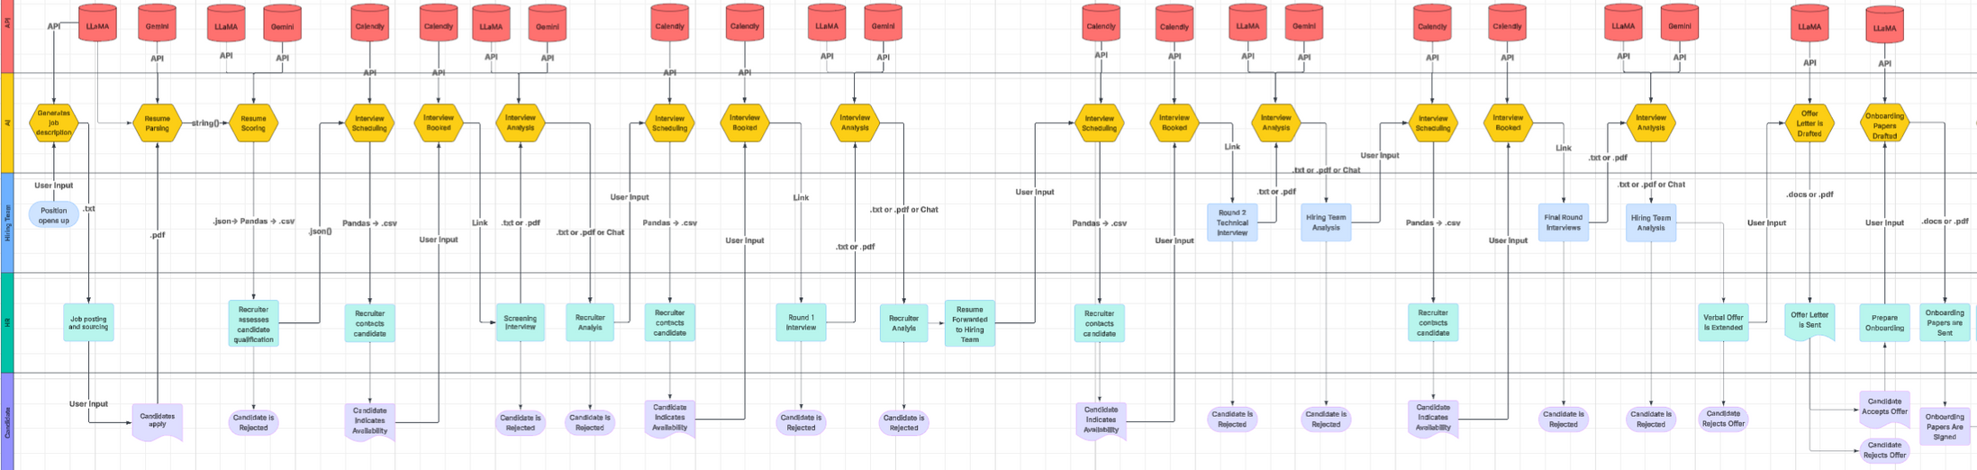
IN THE LOOP
Human

Slide 5
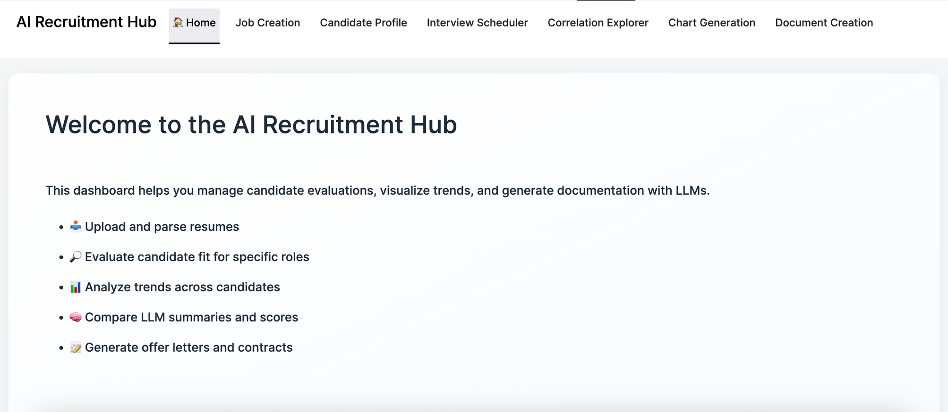
LIVE DEMO

Slide 6
BUSINESS
Impact
Process | Job Posting | Application Screening | Interview Scheduling | Candidate Evaluation | Hiring Decision | Offer | Onboarding (Contract)
Page | Job Creation | Candidate Profile | Interview Scheduler | Correlation Explorer | Chart Generation | Document Creation | Document Creation
Before AI | 1-3 days | 30-60 mins | 1-2 days | 45-60 mins | 3-7 days | 1-3 days | 1-3 days
After AI | 15-30 mins | 5-10 mins | 5-10 mins | 15-30 mins | 12-48 Hours | <1 day | 15-30 mins
Potential Savings
Small Tasks: 30+ min
Large Tasks: 12+ Hours
Quality Improvement
More consistent scoring, faster responses, and cleaner contracts

Slide 7
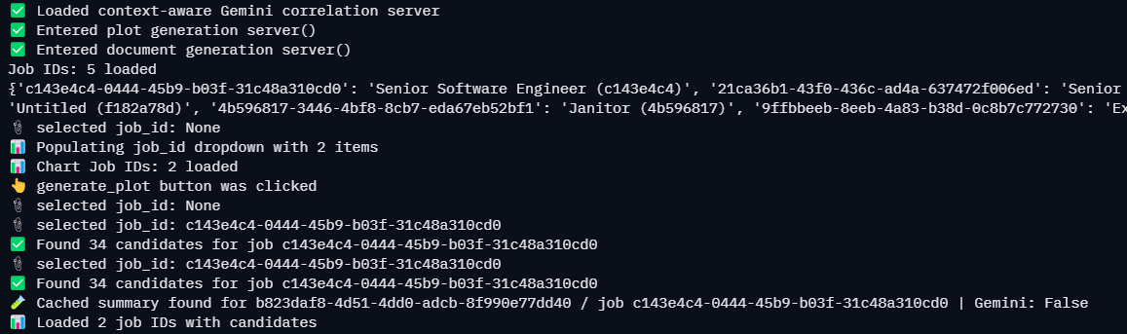
LESSONS
1. Importance of Debugging
Tool Calling Issues
Data Pathing
Package Compatibility with Shiny

Slide 8
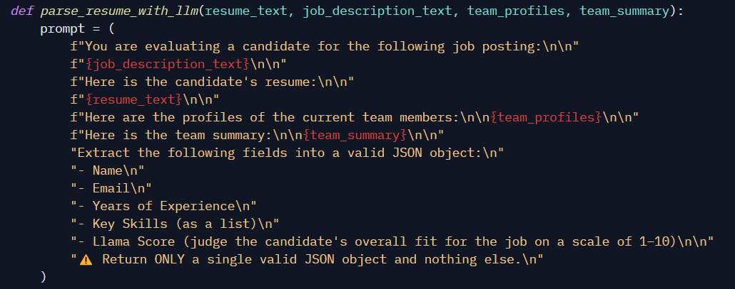
LESSONS
2.. LLM Limitations
Token Generation Limits
Overkill? (Understanding Good Use Cases)
Importance of Prompting

Slide 9
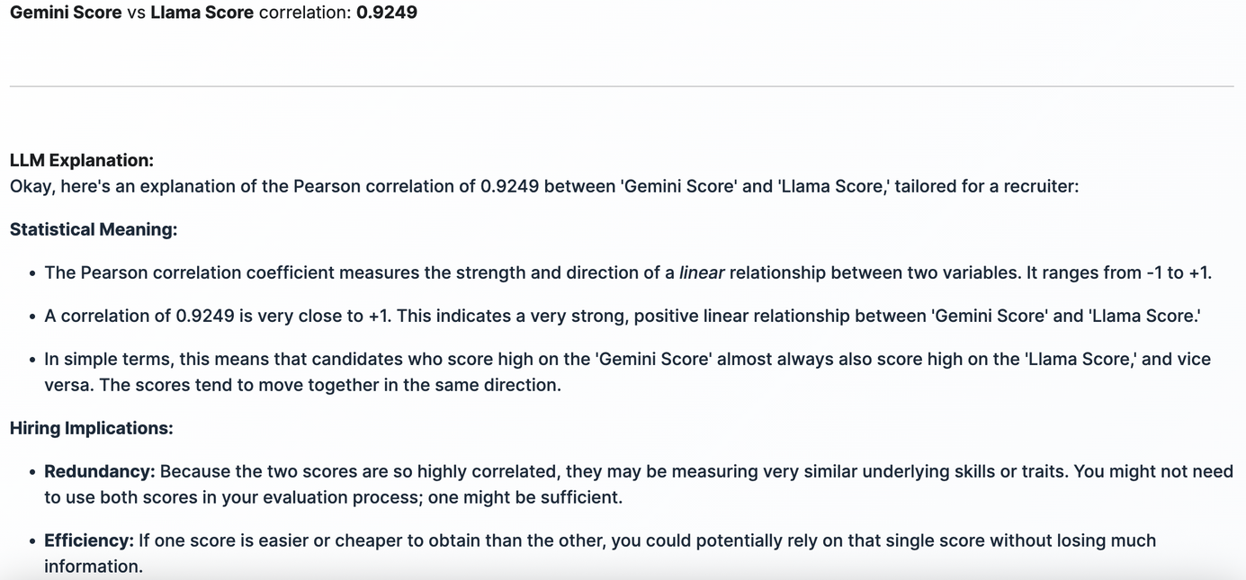
CHALLENGES
1. Business Challenges
Bias, fairness, overreliance
Legal/compliance bottlenecks
Recruiter trust in AI outputs

Slide 10
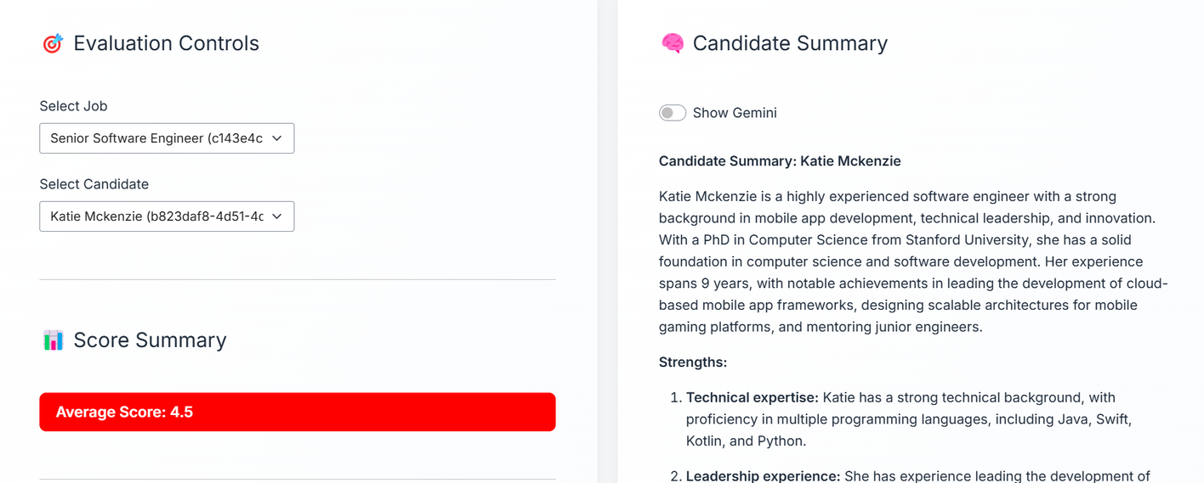
CHALLENGES
2. Technical Challenges
Prompt design, output validation
Multi-tab context sync
Token + latency management
Resume parsing, OCR issues

Slide 11
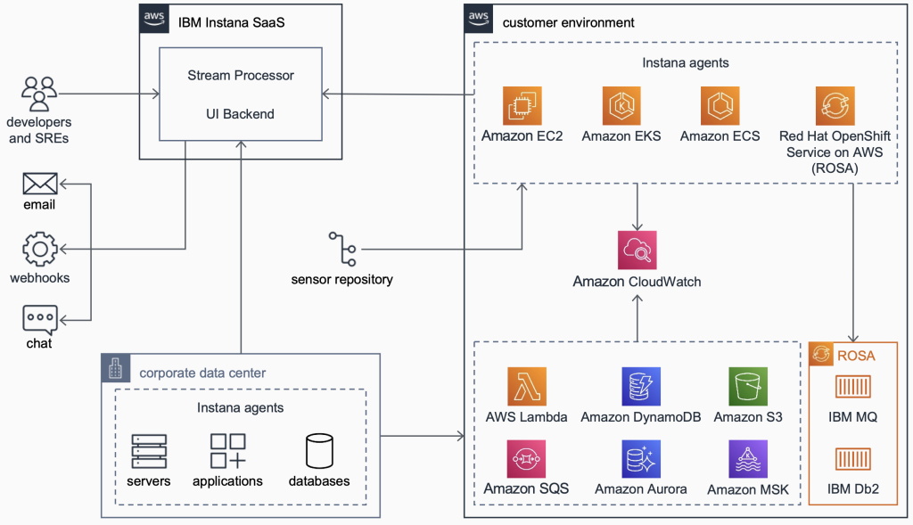
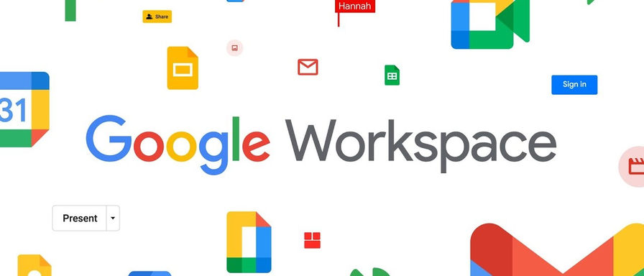
Future
Development
Data Base Integration
API Customization

Slide 12


THANK
You

